Slide 1
FORCE AND PRESSURE
Submitted by Name - Pratik Srisant Toppo Class – 8C Roll.No – 42
Submitted to
Mrs.Rashmi Srivastava

Slide 2

Acknowledgement
I would like to express my special thanks of gratitude to my Physics teacher "Mrs. Rashmi Srivastava" for their able guidance and support in completing my project work I would also like to extend my gratitude to the Principal “Fr. Ignatius lakra S.J” for providing me with all the facility that was required.
Date – 1/08/2022 Pratik Srisant Toppo
Class – 8C

Slide 3
Table of Content
Introduction
Force
Turning effect of a force Page 1 Page 2
Factors affecting the turning effect of a body
Opening of door by push or pull
Turning of hand flour grinder
Turning of a potter’s wheel
Turning of a drill machine

Slide 4
Table of Content continued
Turning of a steering wheel
Turning of a wheel of a bicycle
Turning of a spanner
Movement of force
Pressure
Conclusion
Bibliography

Slide 5
Introduction
A force is a push or pull upon an object resulting from the object’s interaction with another object. The turning effect of a force is more if the distance between the point of application of force and the hinge on a door is more. It is given a special name – Moment of force. Pressure is defined as force per unit area. Solids, liquids, and gases all exert pressure. The atmosphere also exerts pressure, activities are carried out to demonstrate that solid, liquid, and gases exert pressure.

Slide 6
Force
A force is a cause of ( push or pull ) which tends to result in movement or change in size or shape of the body. A force when applied as a push or pull on a stationary body that is free to move, can produce motion in it and if applied on a moving body, it can change the speed of motion of a body (i.e can speed up or slow down the moving body) or it can change both the speed and direction of motion. Similarly, the shape or size of a non-rigid body can also be changed by applying force. However, if an object does not move on the application of force or its size and shape do not change, then in the language of Physics, we say that force is not fruitful.

Slide 7
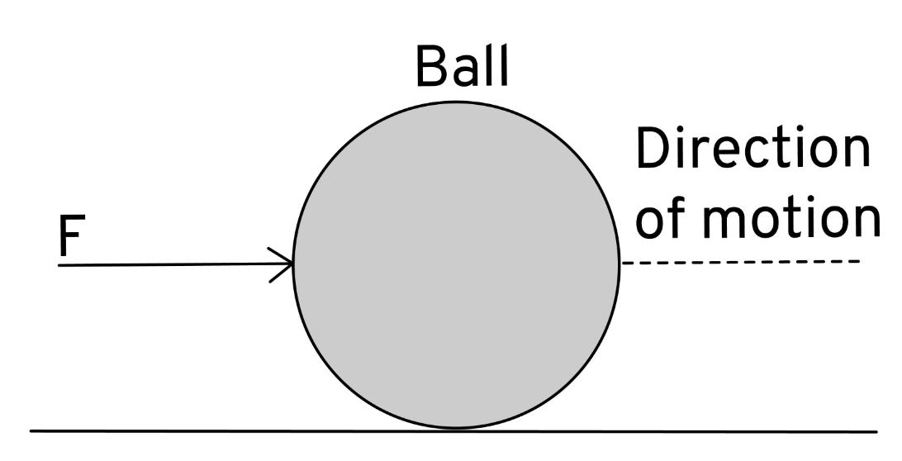
Turning effect of a force
Force is applied on a stationary rigid body, it starts moving on a stationary rigid body, it starts moving in a starting line in the direction of force as shown, a ball moves on a pushing.

Slide 8
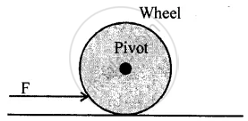
Turning effect of a force
Now if the body is not free to move, but it is pivoted a point O and a force F is applied at a suitable point A, it begins to turn about point O.
The Vertical axis passing through the point O about which the body turns is called the axis of rotation. In the diagram, on pushing, the wheel begins to turn about its pivoted point O.

Slide 9
Factors affecting the turning effect of a body
The turning effect of a force on a body depends on the following two factors :
1. The magnitude of the force applied.
Larger the magnitude of force applied, more is the turning effect on the body
2. The Perpendicular distance if the force from the pivoted point.
Large and Perpendicular distance of point at which the force is applied, from the pivoted point, more is the turning effect on the body.

Slide 10
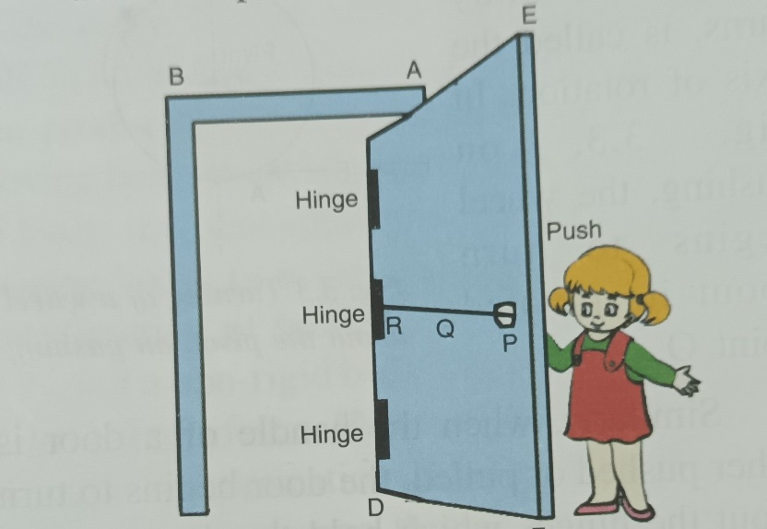
Opening of door by push or pull
To open or shut a door, we apply a force (push or pull) F normal to the door at its handle P which is provided at the maximum distance from the hinges as shown. We can notice that if we apply the force at a point Q (near the hinge R), much greater force is required to open the door and if the force is applied at the hinge R, we will not be able to open the door howsoever large the force may be. Thus, the hand P is provied near
the free end of the door that a smaller force at a
larger perpendicular distance, produces required
turning effectof force to open or to shut the
door.

Slide 11
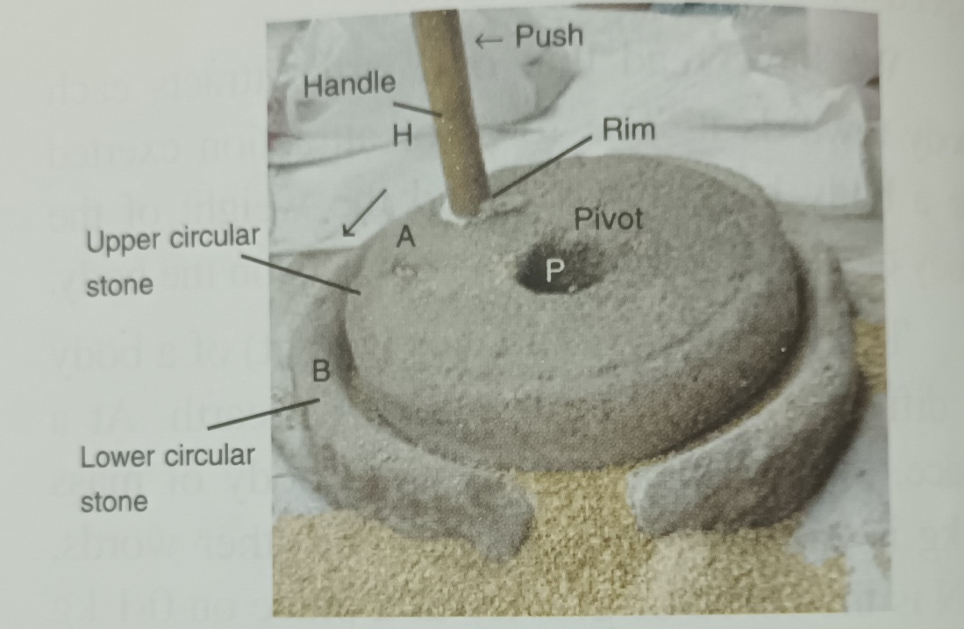
Turning of hand flour grinder
The upper circular stone A of a hand flour grinder is provied with a handle H near its rim (i.e at the maximum distance from the center) so that it can easily be rotated about the iron pivot P at its center by applying a small amount of force at the handle H.

Slide 12
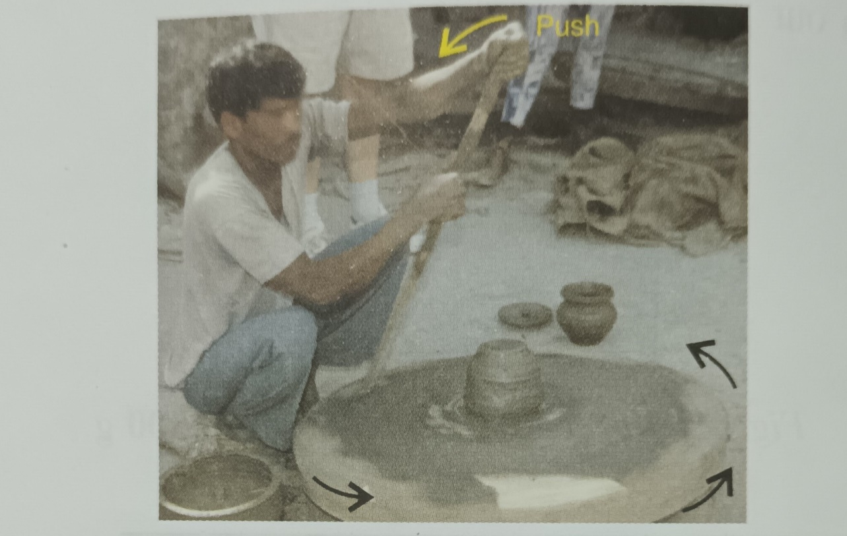
Turning of a potter’s wheel
A potter’s wheel has a wheel pivoted at the center. The potter turns the wheel by means of stick at the rim of the wind as shown.

Slide 13
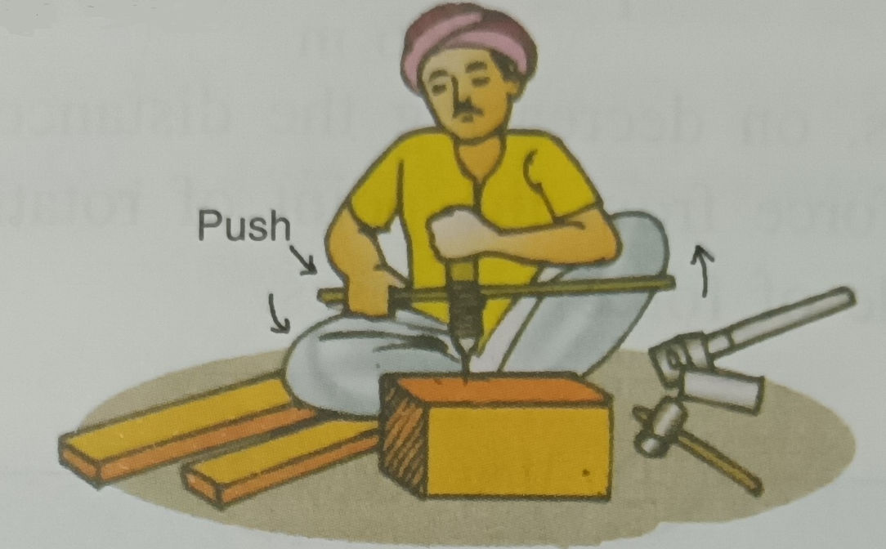
Turning of a drill machine
A carpenter uses a drill machine that is provided with a handle so that by applying less force at the end of the handle, the drill can be turned easily.

Slide 14
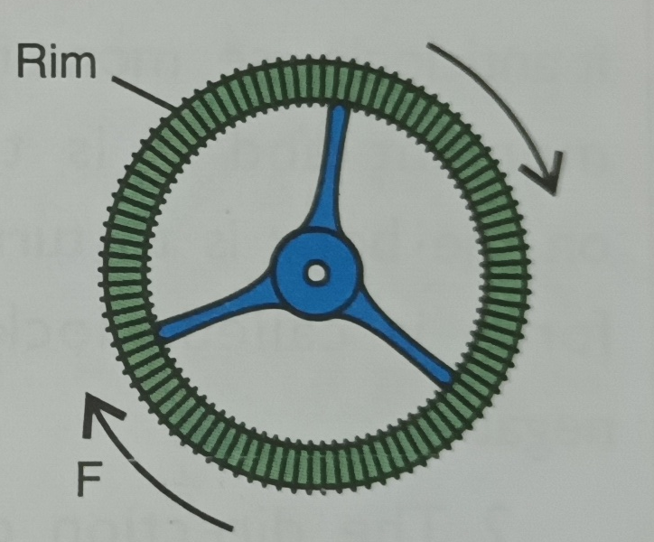
Turning of a steering wheel
To turn a steering wheel in a car or truck, the driver applies force at a point on the rim of the wheel as shown.

Slide 15
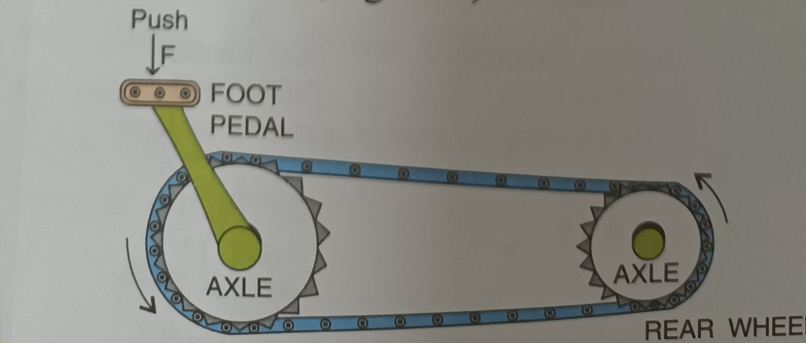
Turning of a wheel of a bicycle
In a bicycle to turn the wheel, the force is applied on the pedal so that the distance of force from the axle of wheel is increased.

Slide 16
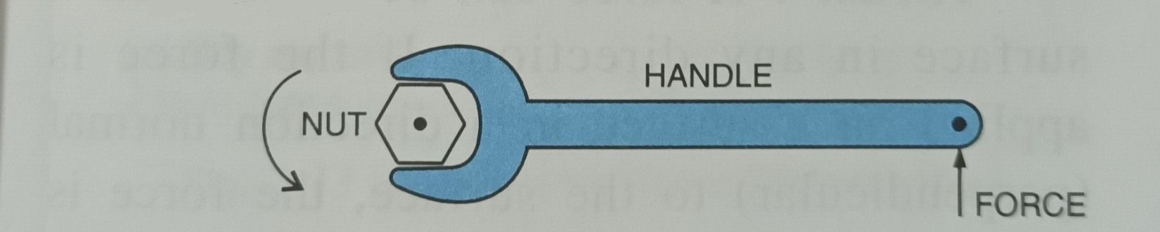
Turning of a spanner
A spanner used to tighten or loosen a nut, has a long handle to produce a large turning effect by a small force applied at the end of its handle as shown.

Slide 17
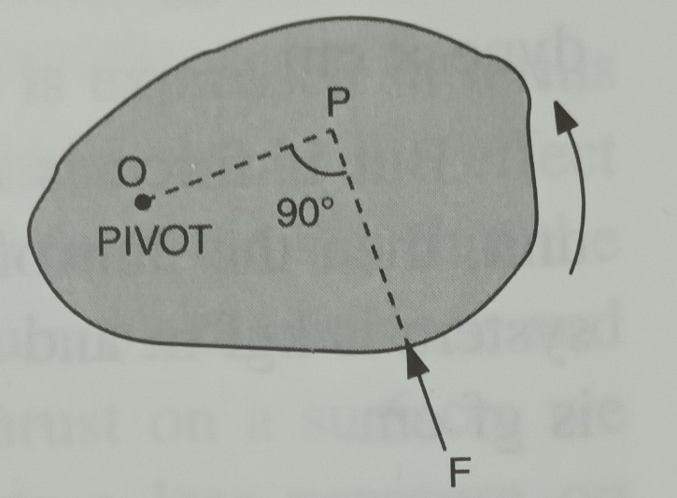
Movement of force
The movement of a force is equal to the product of the magnitude of the force and the perpendicular distance of the force from the provied point.
Consider a body which is provied at a point O. if a force F is applied on the body in the direction FP as shown. The force is unable to produce linear motion of the body in its direction because the body is not free to move, but this force turns (or rotes) the body about the
point O,in the direction shown by the arrow.

Slide 18
Pressure
Thrust – A force can be applied on a surface in any direction. If the force is applied on a surface in a direction normal (perpendicular) to the surface, the force is called thrust. Thus, the force acting normally on a surface is called thrust. A body, when placed on a surface, exerts a thrust on the surface equal to its own weight.
The unit of thrust is sane as that of the weight of force. Thus, the units of thrust are kilogram force (kgf), gram force (gf) and newton (N). These units are related as:
1 kgf = 1000gf
1 kgf = 10N (nearly)
1N = 100gf (nearly)

Slide 19
Conclusion
Here, I have come to the end of the project on the topic "FORCE AND PRESSURE".
I would like to share my experience while doing this project. I learnt many new things about force and pressure and it was a wonderful learning experience for me while working on this project. This project has developed my thinking skill and more interest in this subject. This project gave me real insight into the Physics world. A very special thanks to my dear Principal sir for setting such target for us. I enjoyed every bit of work. I put into this project. I do hope that my project will be interesting and maybe even knowledgeable.
THANK YOU..

Slide 20


Bibliography
I “Pratik Srisant Toppo of class 8’c’ have done this project with the help of my parents, my sister, and my friends.
I used –
Note book
Text Book of Physics
Website - https://pratik-project-source.github.io/physics
Copy of physics project download

